Slide 1
Unit 6 For Live Session Assignment
Isabella Westlauer
2/8/2026

Slide 2
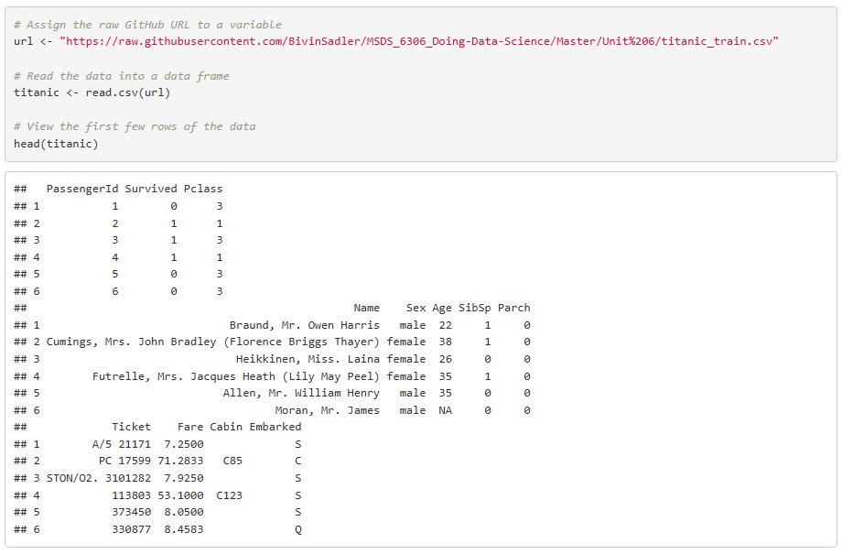
Fetch and Inspect the Titanic Dataset
Notes:
Download the training set: You can download data sets directly from GitHub! Use this link to download the titanic dataset directly from our GitHub repo. Simply use this link and enter it as a string into read.csv(). If you are having difficulty, simply download it from GitHub and move on. We will cover it in class.
https://raw.githubusercontent.com/BivinSadler/MSDS_6306_Doing-Data-Science/Master/Unit%206/titanic_train.csv

Slide 3
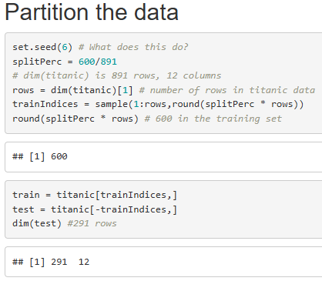
Set.seed() makes the results reproducible. If you set your seed the same as mine, your sample will have the same random selection.
trainIndices is a set of 600 indices selected from the number of observations in the titanic dataset.
train has 600 random observations from the titanic dataset, and test has the remaining observations.
The minus sign works the same way that titanic[-1,] refers to the last observation in the set.
Notes:
Randomly partition the 891 observations into a smaller “training” set of 600 and a ”testing” set of 291 observations.

Slide 4
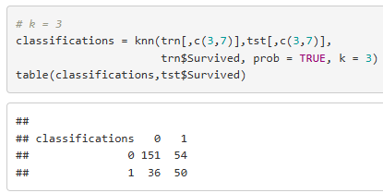
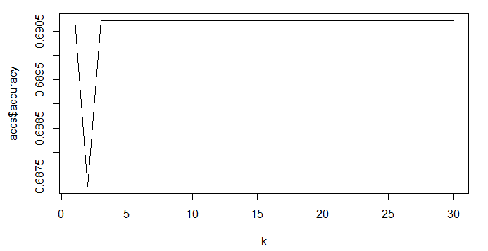
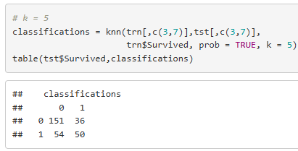
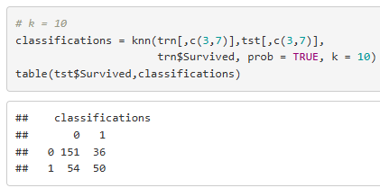
Classifications with K = 3, 5, 10 (OOPS)
Why does the outcome look the same for different values of k? OH!! I thought Age was in column 7, but it was really in column 6. So, how do I avoid this mistake? Is there a programmatic way to find column index by the header name?
Notes:
Use KNN and the new training set (the 600 observations) to classify those who survived and died in the new testing set (the one you just created with 291 observations) using age and class.

Slide 5
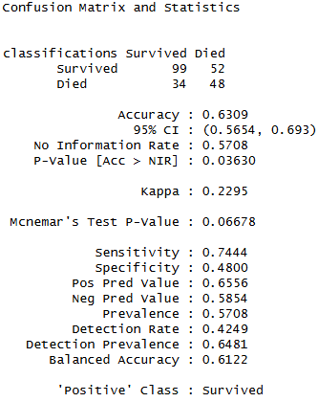
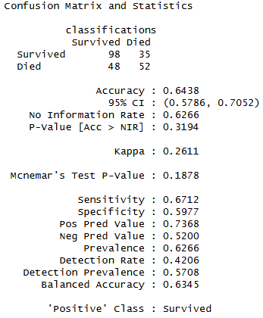
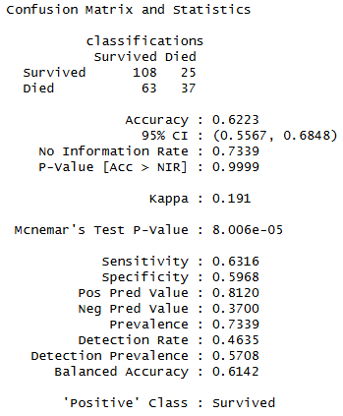
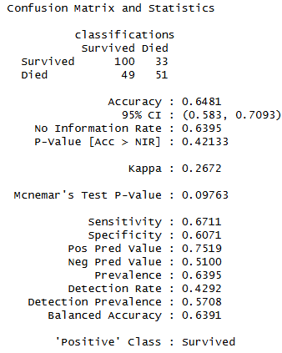
Classification Accuracy, Sensitivity, and Specificity
k = 3
k = 5
k = 10
k = 20
The accuracy, sensitivity, and specificity are comparable between these values of k.

Slide 6




Confusion Matrix
$$Accuracy= \frac{201}{291}=.6907$$
True Survival
 | 0 - Died | 1 - Survived
0 | 151 | 54
1 | 36 | 50
$$Missclassification Rate= \frac{90}{291}=.3093$$
Classifications
True negative
False negative
False positive
True positive
$$Sensitivity= \frac{151}{187}=.807$$
$$Specificity= \frac{50}{104}=.480$$
What do sensitivity and specificity actually mean?
I assume survived =1 to be successes (positives), and survived =0 to be failures (negatives)
Notes:
Create a confusion matrix and calculate the accuracy, misclassification rate, sensitivity and specificity. Be prepared to explain these statistics. (It is ok if you have questions here… we will answer them in live session … just do your best.)
Accuracy
Number of correctly classified observations/total: 16/25 = .64 = 64%
Misclassification rate:
Number of misclassified observations/total: 9/25 = .36 = 36%
Sensitivity:
Number of correctly identified successes/true number of successes: 10/15 = .66 = 66%
Specificity:
Number of correctly identified failures/true number of failures. 6/10 = .60 = 60%

Slide 7
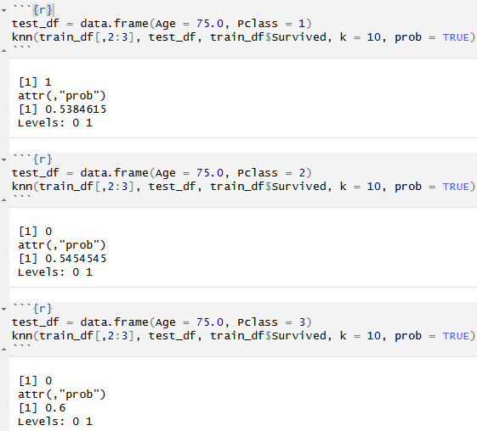
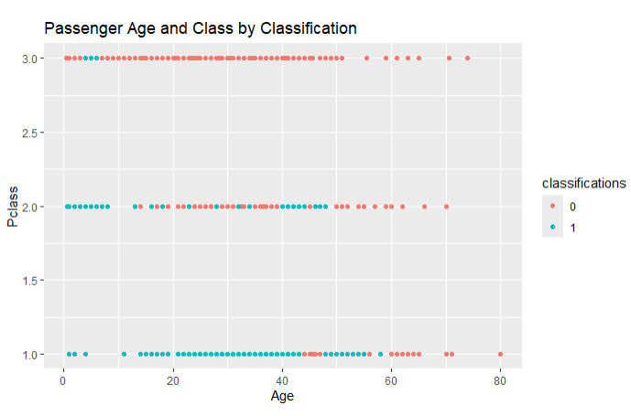
Survival Probability of a 75-year-old in Different Passenger Classes
Note the accuracy of the model is less than 65%
3rd class: 40.0%
2nd class: 45.5%
1st class: 53.8%
For a passenger aged 75, in any class they would likely not have survived, but it makes sense that the probability of survival slightly increases in higher classes.
Notes:
Pick an age and predict the survival probability of a person that age based on each of the ticket classes.

Slide 8
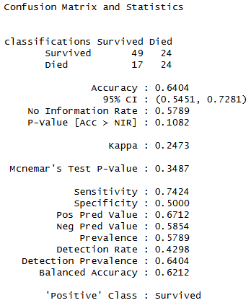
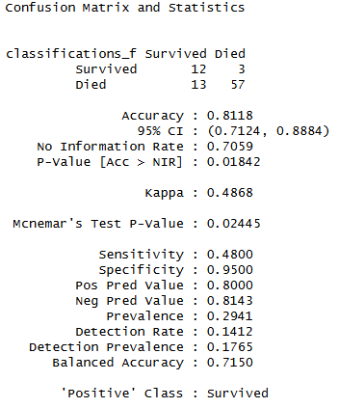
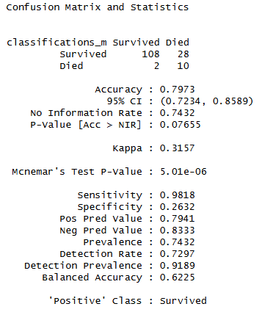
Compare Classification of all Passengers vs Males vs Females
All Passengers
Female Passengers
Male Passengers
Accuracy is improved once splitting the data by sex. Why is that? How do we compare the sensitivity and specificity?
Notes:
Create separate models for males and females and compare the resulting classification statistics after using the models to classify those in the test set.

Slide 9
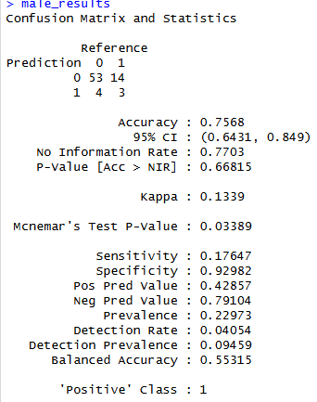
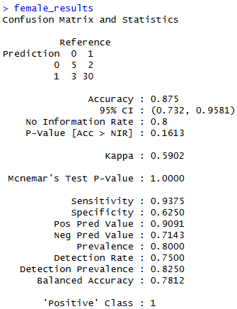

ChatGPT
The code ran. It did not produce any visualizations, but the results were like mine in part 1, once I switched the seed to my seed. For part 2, I changed the age to 75, to compare to my test but the results were much different.
Part 1: Very similar to my results
Accuracy 0.6491228 Accuracy 0.3508772 Sensitivity 0.4897959 Specificity 0.7692308
Part 2: very different from my results, but
more consistent with the actual data than
mine, why?
Part 3: similar to my results
Notes:
Use ChatGPT to attempt this assignment. Generate and run the code as is. Did it run? Did it give the desired results?
Make a PowerPoint to present in Live Session

Slide 10
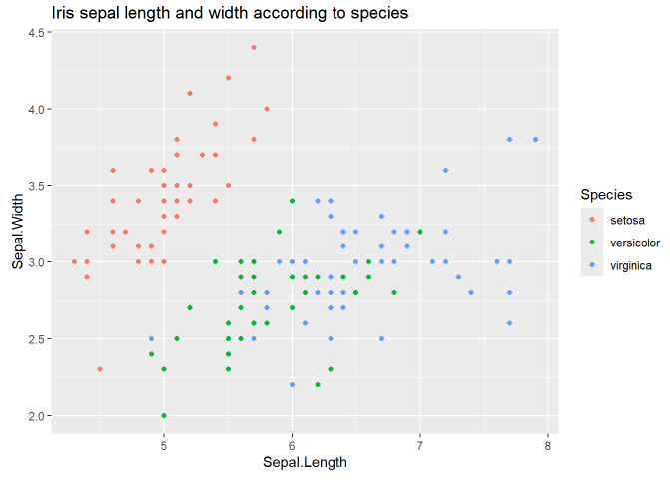
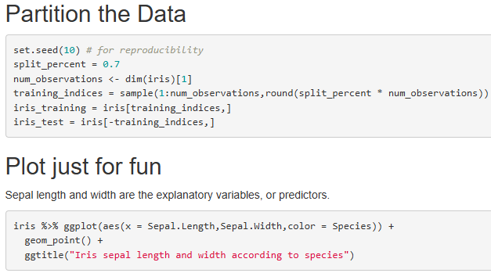
Inspect Iris Dataset and Partition into Training and Test Sets
Notes:
a. For the full (multinomial) IRIS data (the iris dataset in R), do a 70-30 train/test cross validation with k =1 - 90 and use sepal length and width as predictors.

Slide 11
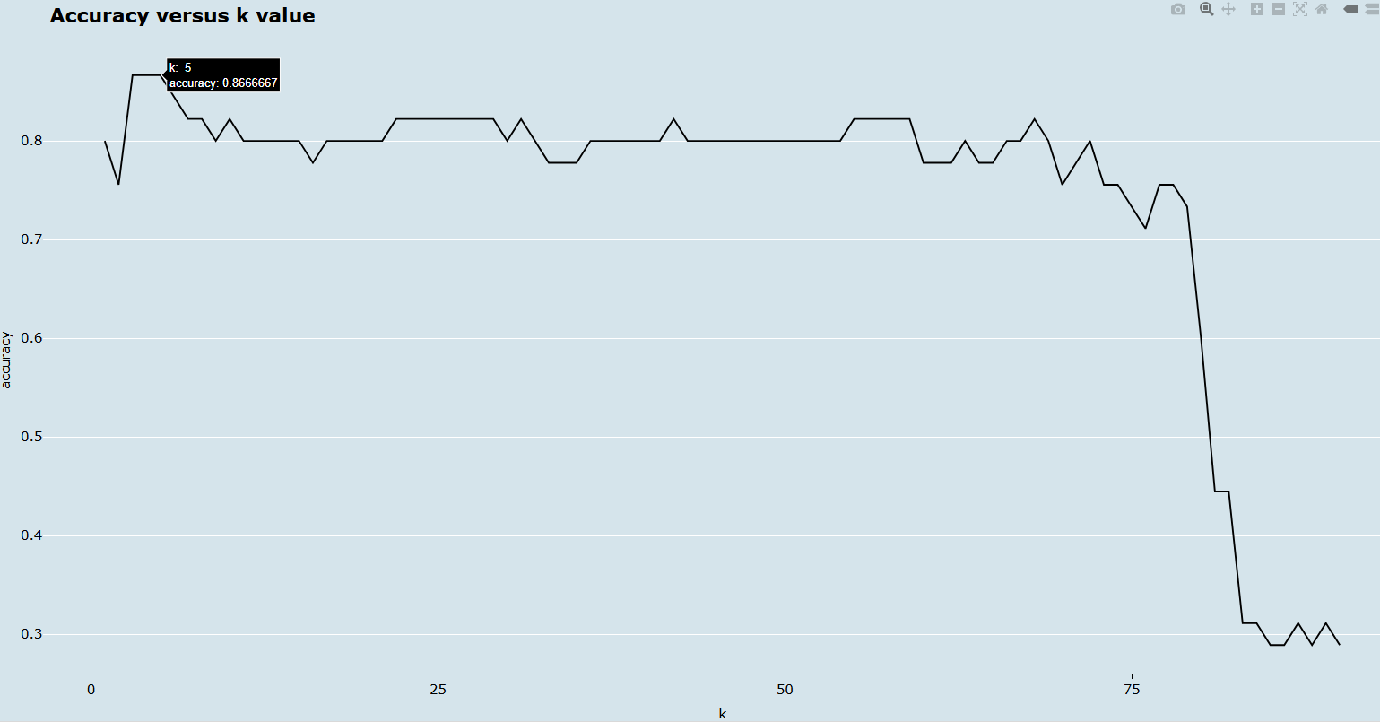
Fine tune the hyperparameter for k =1 to 90
According to the plot, k =3, 4, and 5 all have the highest accuracy.
I would go with 5, but that’s just an instinct. I can’t think of any reason why 5 would be better than 3 since they have the same accuracy???
Notes:
Make a plot of k (xaxis) versus accuracy. Use this plot to tune the hyperparameter k. What do you feel is the best value of k?

Slide 12
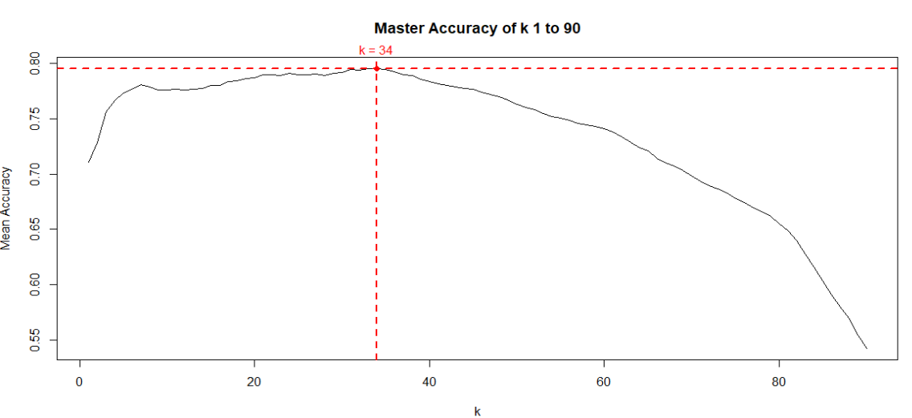
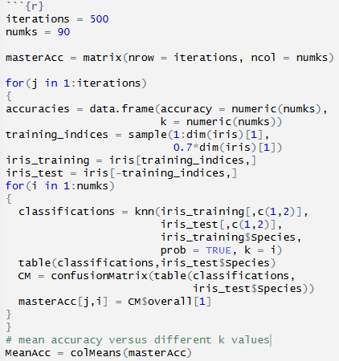
Fine tune the hyperparameter for k =1 to 90
From this plot, the best k value is 34
Notes:
# plot code
p <- plot(seq(1,numks,1), MeanAcc, type = "l", xlab = "k", ylab = "Mean Accuracy", main = "Master Accuracy of k 1 to 90") # how do I use plotly to get interactive?max_mean_acc <- max(MeanAcc)best_k <- which(MeanAcc == max_mean_acc)points(best_k, MeanAcc[best_k], pch = 19, col = "red")abline(h = max_mean_acc, col = "red", lty = 2, lwd = 2)abline(v = best_k, col = "red", lty = 2, lwd = 2)par(xpd = TRUE)text(best_k, max_mean_acc, labels = paste("k =", best_k), pos = 3, offset = 1, col = "red")par(xpd = FALSE)

Slide 13
Takeaways and Questions
I could use the header instead of the column index, but what is a better way to find the index of a column if you know the header?
When do we do internal cv versus external cv, or both?
In the titanic dataset, can I assume that Survived = 0 means they didn’t survive? How do I find out?
When I fine tune the hyperparameter k, if multiple k values have the best accuracy– which one should I choose? Does it matter?

